Slide 1
A-Z STORE
CS211245 AYESHA ABBAS
CS211246 SAAD NISAR BUTT
CS211247 ADINA MUHAMMAD SHOAIB
IICT PROJECT

Slide 2

A-Z STORE
OUR WEBSITE HOME PAGE

Slide 3


NAVBAR
Navigation bar with hover able effect
Products page leads us to another page that contains nested pages for details, ladies and kids wear
Here user can see there cart items and calculation oftotal price
User can create and login in to his/her account
User can contact us throught filling up form and other linkages
LOGO
THIS IS OUR LOGO AND OUR STORE’s NAME

Slide 4
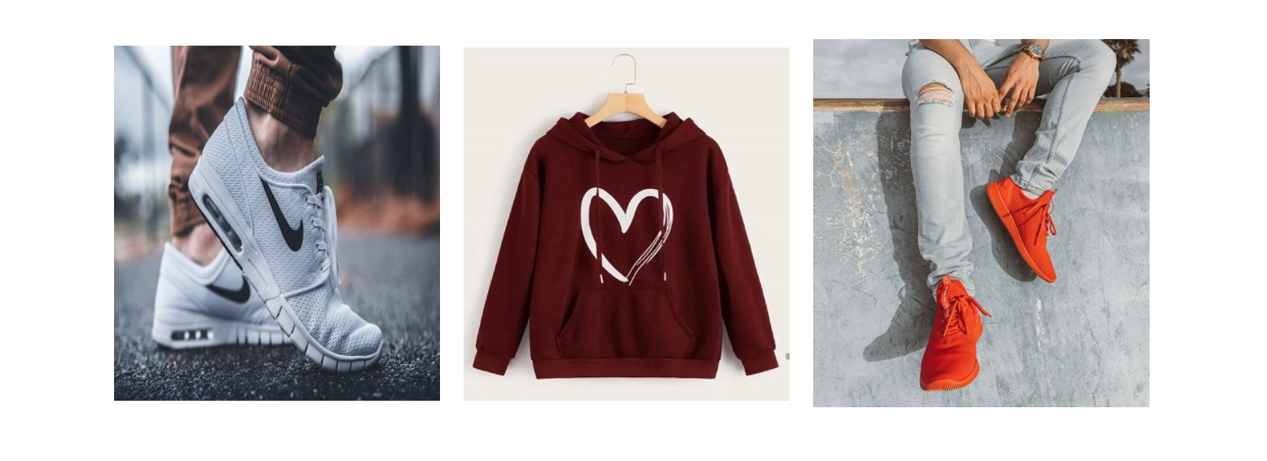
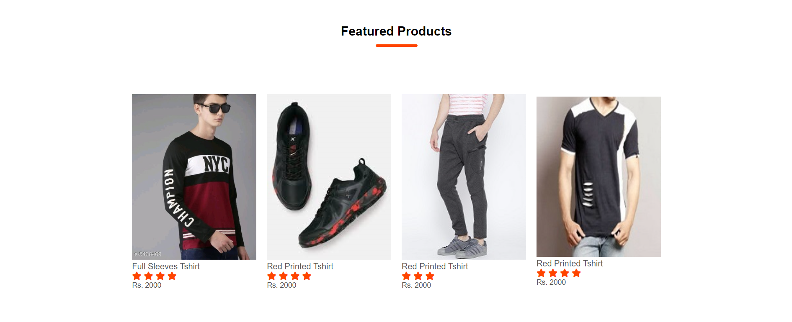
Latest & New Arrivals
Featured products are shown in Home Page

Slide 5
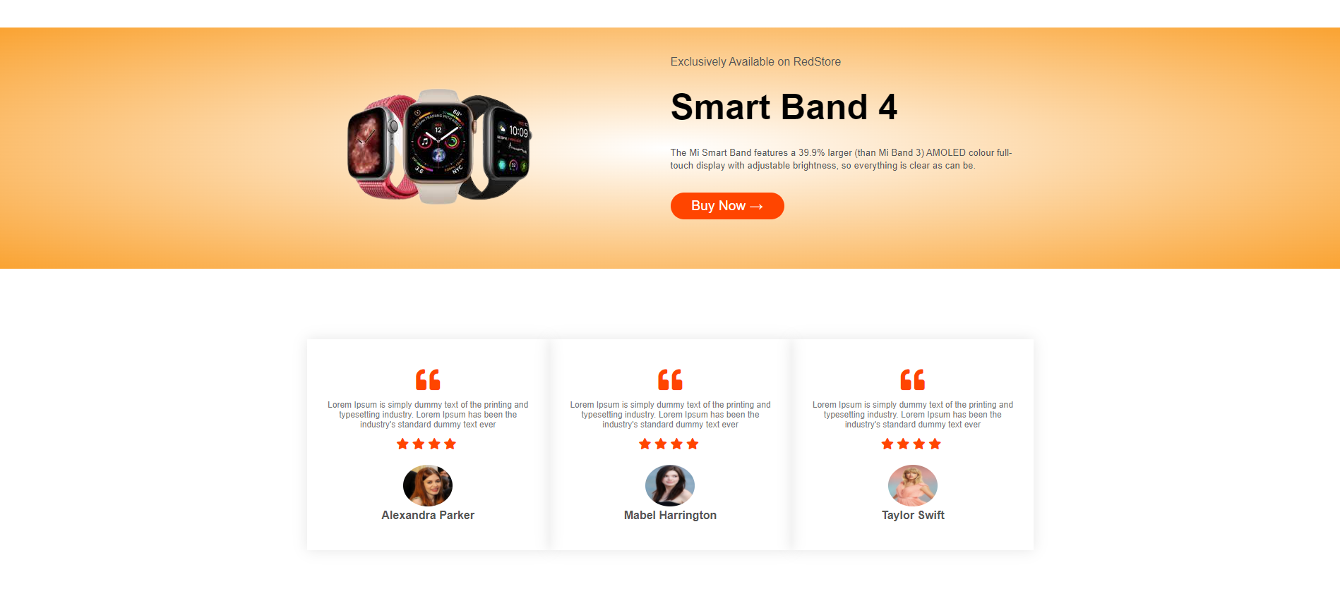
Smart watches and Bands updates shown here
Reviews and Ratings from our frequent customers

Slide 6

This is our footer which contains some basic information.

Slide 7
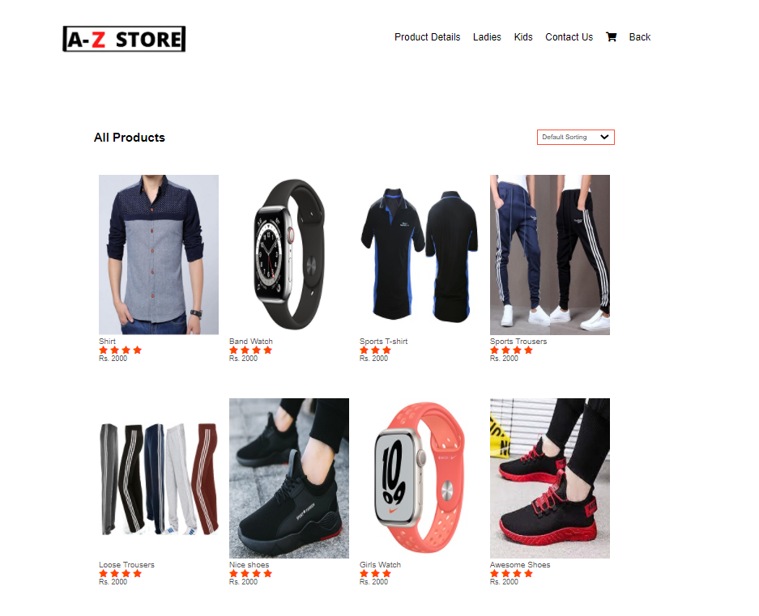
Nav bar for our products page
HERE WE MADE PORTION OF MEN’s FOR SHOPPING PURPOSE, WHERE THERE ARE MEN PRODUCTS

Slide 8
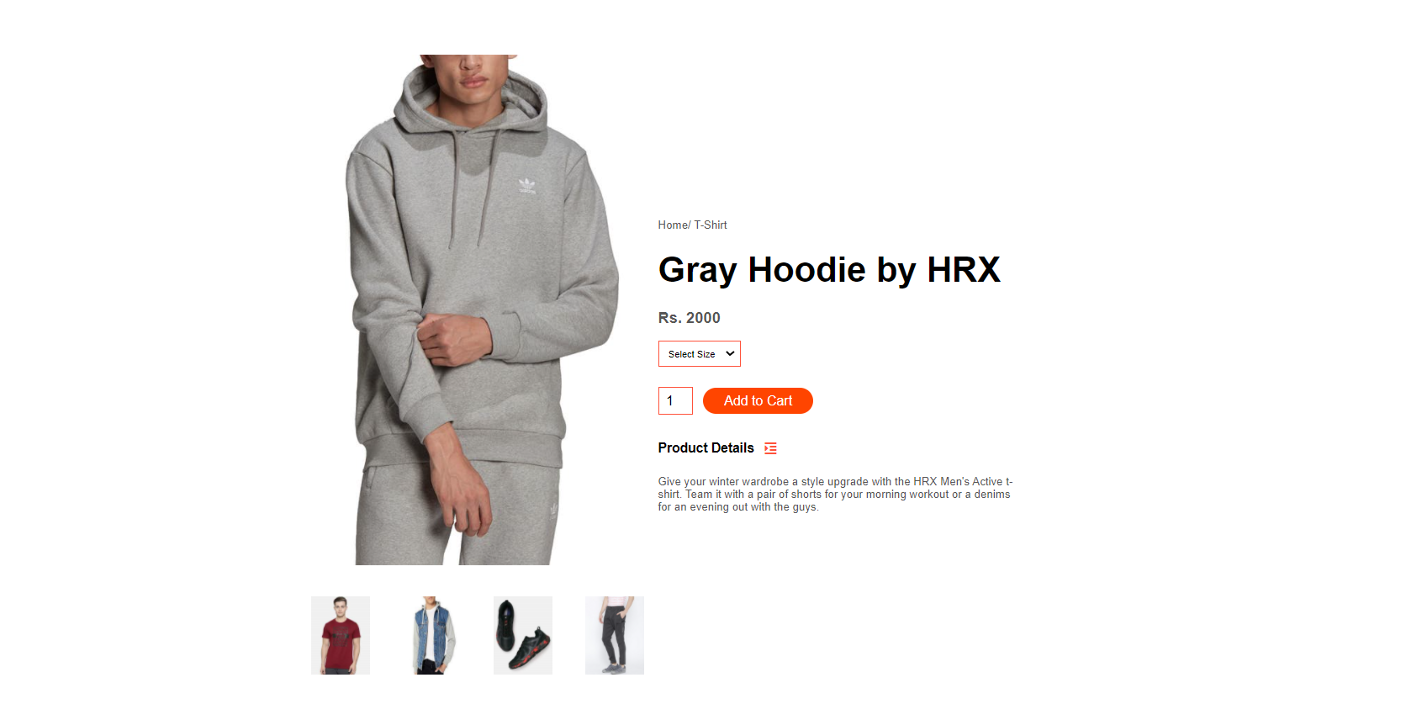
PRODUCTS DETAILS PAGE
Details are available on this page for products at store

Slide 9
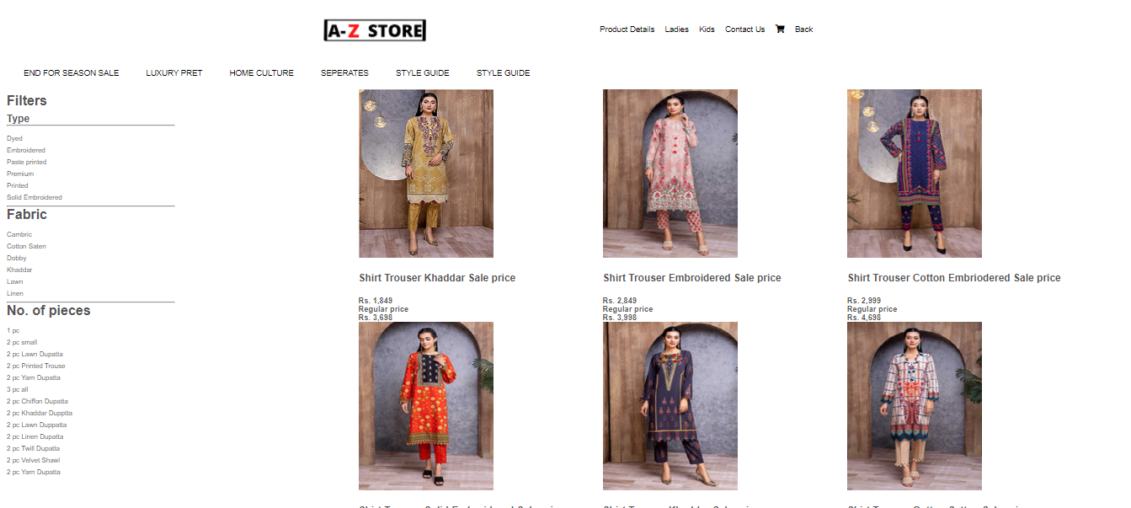
LADIES PORTION
HERE WE MADE WOMEN’S PORTION ,WHERE WOMEN’S DRESSES ARE AVAILABLE

Slide 10
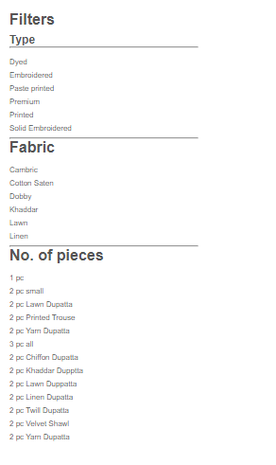
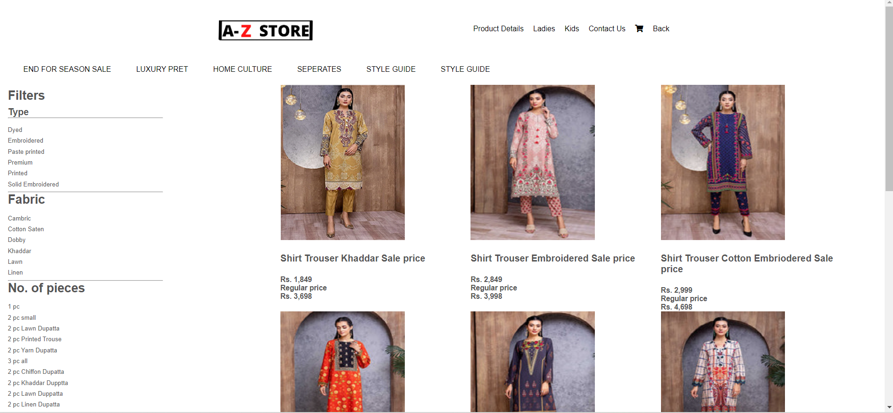
A list for different types of fabrics available for women
Information regarding ladies product available at the store

Slide 11
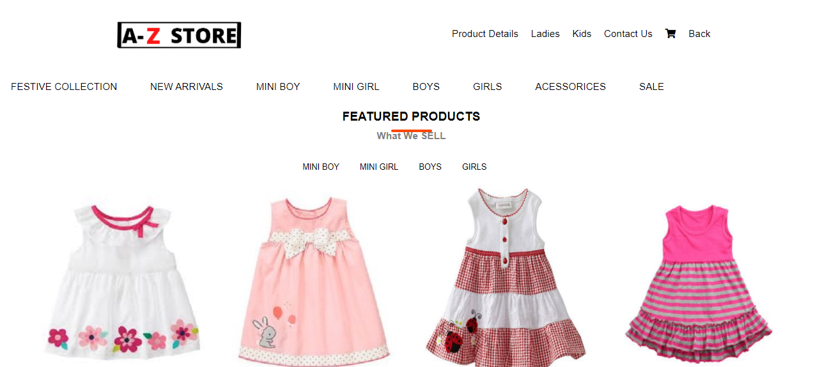
KIDS PORTION
HERE WE MADE KIDS PORTION, WHERE KIDS CLOLTHES ARE AVAILABLE

Slide 12
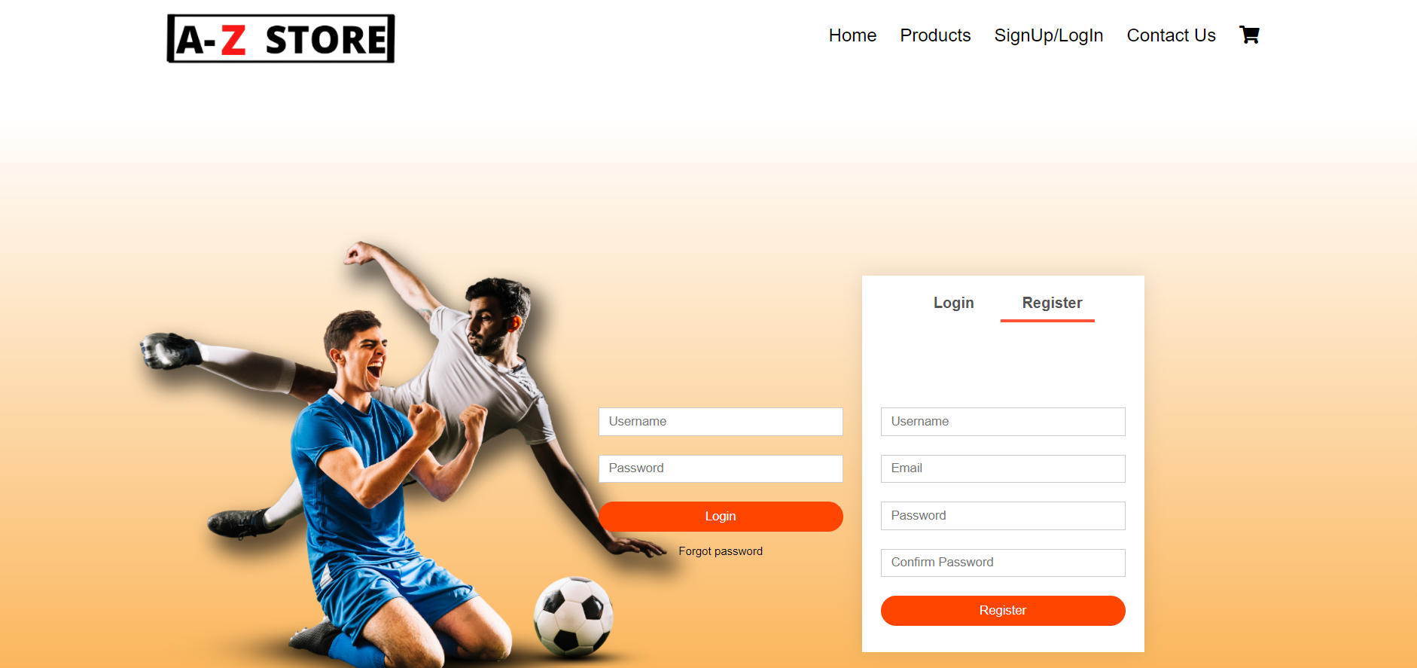
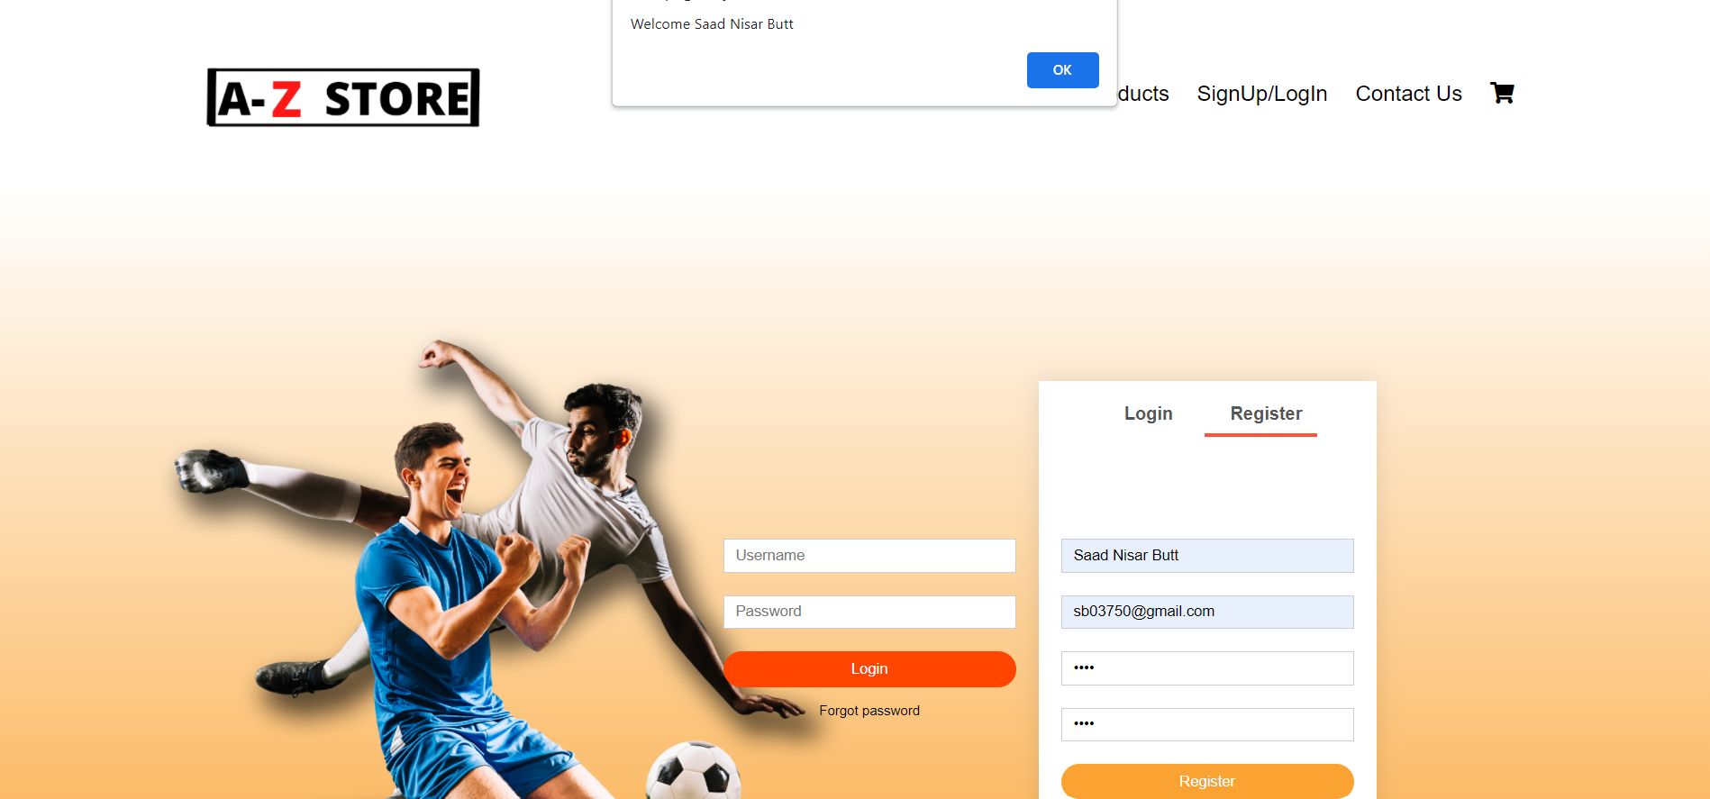
SIGNUP/LOGIN PAGE
Registration form with data validations
An alert box on submit
Alert box welcoming user

Slide 13
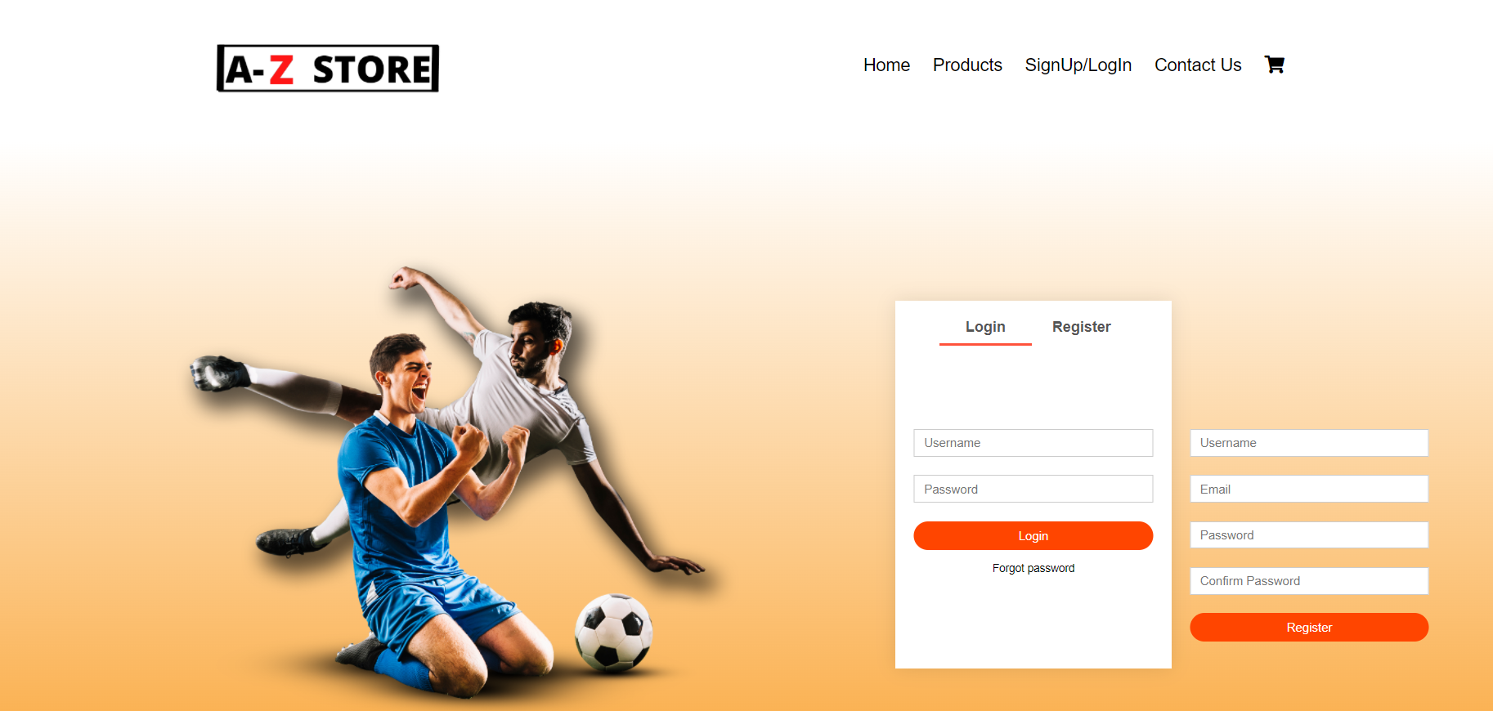
LOGIN FORM

Slide 14
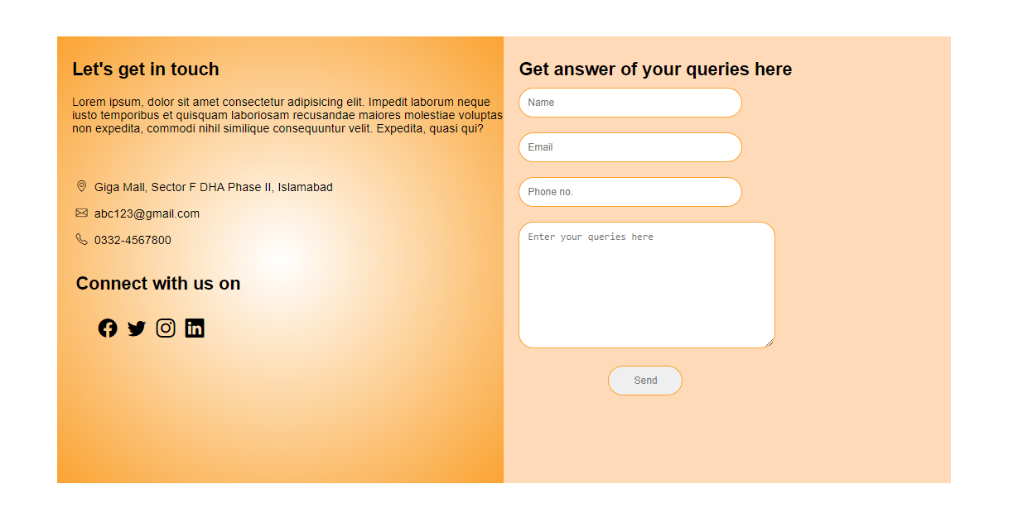
CONTACT US PAGE
With valid input, user can submit their queries.
Some other contacts information for our customers

Slide 15
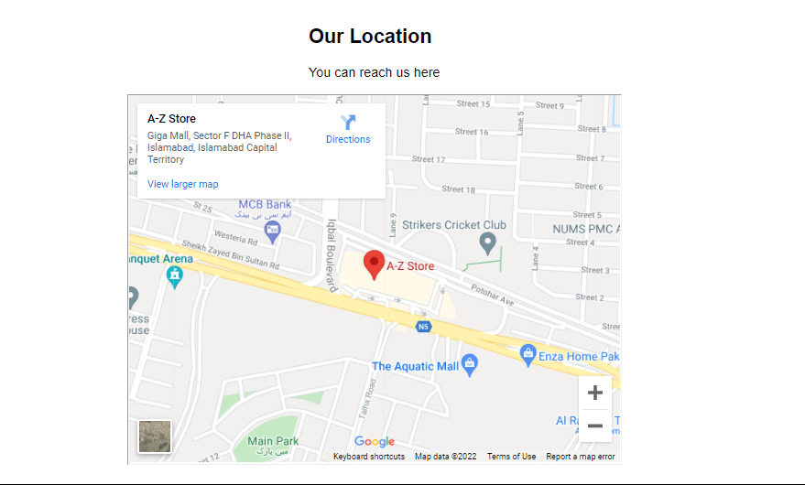
CONTACT US PAGE
Embedded location through
iframe

Slide 16
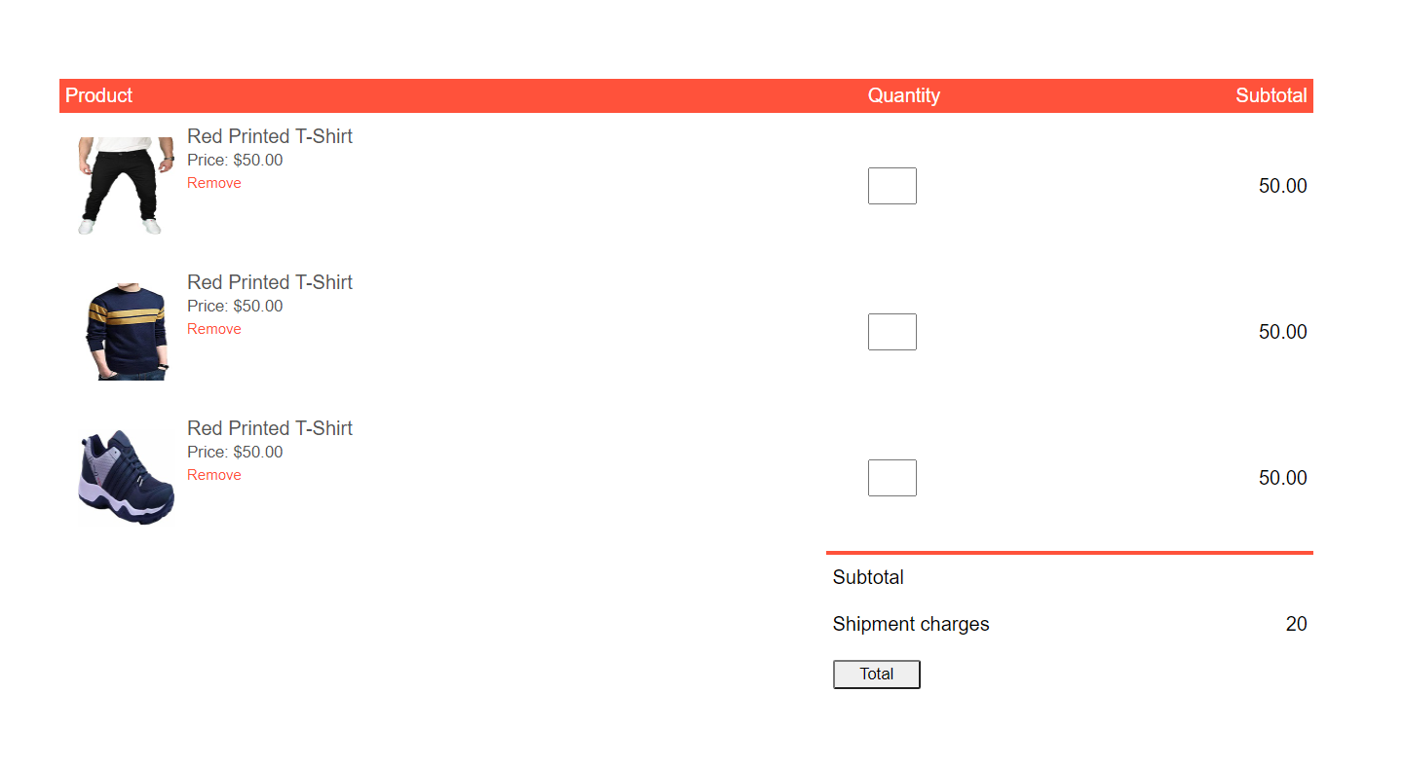
ADD TO CART PAGE
Customer can see their total bill here

Slide 17
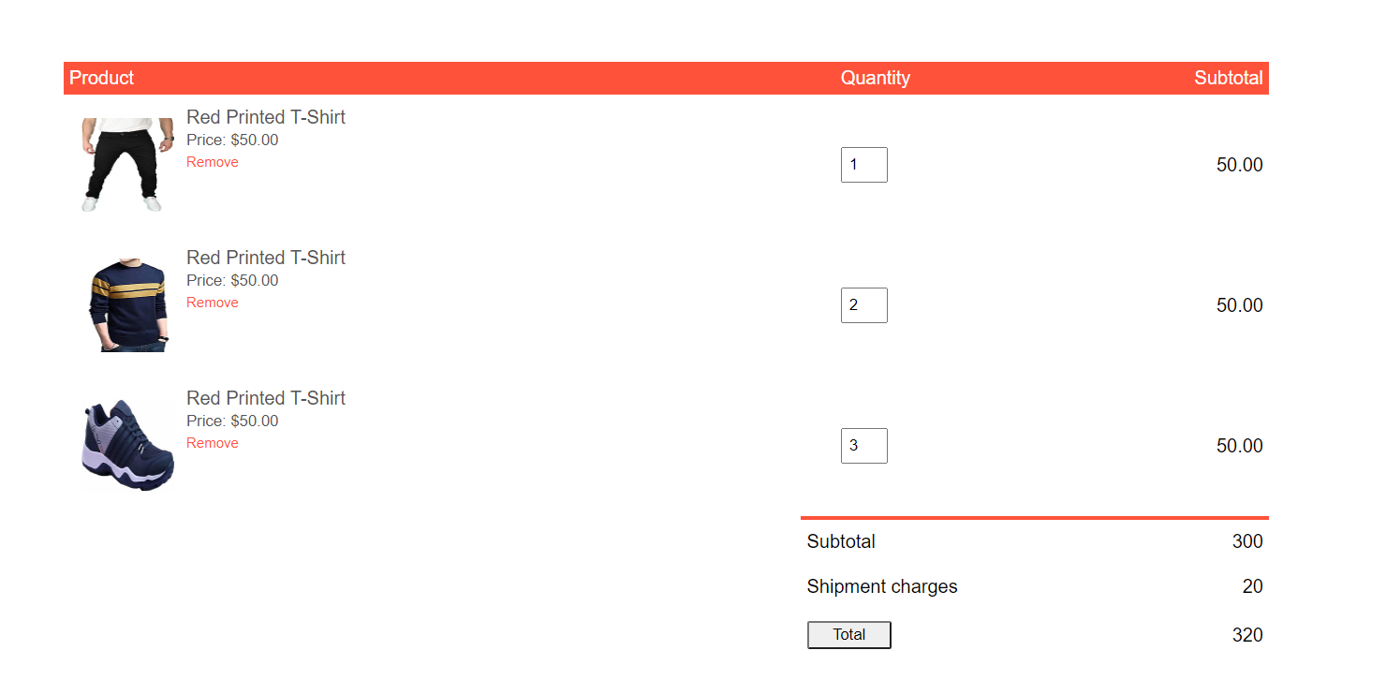
Input quantity
On clicking here
Total amount

Slide 18
THANK YOU

